Slide 1
Texas Prescription ​
Monitoring Program ​101​
Texas Targeted Opioid Response

Slide 2
What is the Texas PMP?​
Statewide electronic database that collects and monitors outpatient prescription dispensation data
for schedule II, III, IV and V controlled substances ​
Managed by the Texas State Board of Pharmacy​
Patient care and safety tool – prevents harmful drug interactions, misuse, diversion, and overdose​

Slide 3
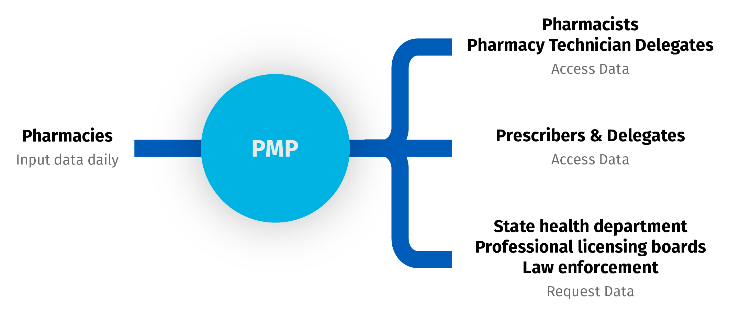
How does the PMP work?​
Accessed via txpmp.org or by integration with Electronic Health Records​
Requires a DEA number, professional license number, and controlled substance ID​
For additional resources, visit txpmp.org.

Slide 4
Checking the PMP is Required by Law​
Prescribers and pharmacists are required by Texas state law to check the PMP for every patient, every time before prescribing or dispensing:​
  Opioids​
  Benzodiazepines​
  Barbiturates​
  Carisoprodol​
Medical pharmacy students, medical residents, and pharmacy technicians may be designated as delegates to check the PMP on behalf of prescribers and pharmacists​
Helps to reduce implicit bias by ensuring that providers make clinical decisions based on objective data for all patients​

Slide 5

How does the PMP benefit patients?​
Responsible prescribing can save lives​
Ensures that patients have access to safe, effective pain management​
Helps providers identify patients who may be at risk for overdose and in need of treatment and recovery services

Slide 6


How does the PMP benefit providers?​
Improve patient safety by allowing providers to​:
Identify patients obtaining prescriptions from multiple prescribers and pharmacies​
Easily identify overlapping prescriptions and prevent harmful drug interactions​
Calculate total amount of opioids prescribed per day (MME/day)​
PMP data can prompt life-saving discussions with patients​
Protects providers from potential medical malpractice lawsuits​

Slide 7
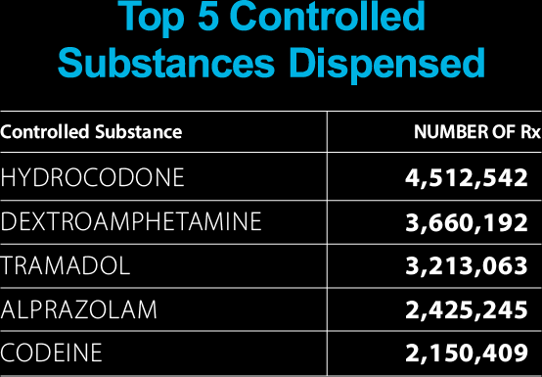
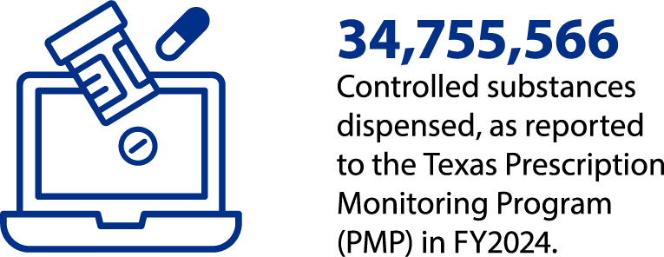
Data:
The Texas PMP

Slide 8
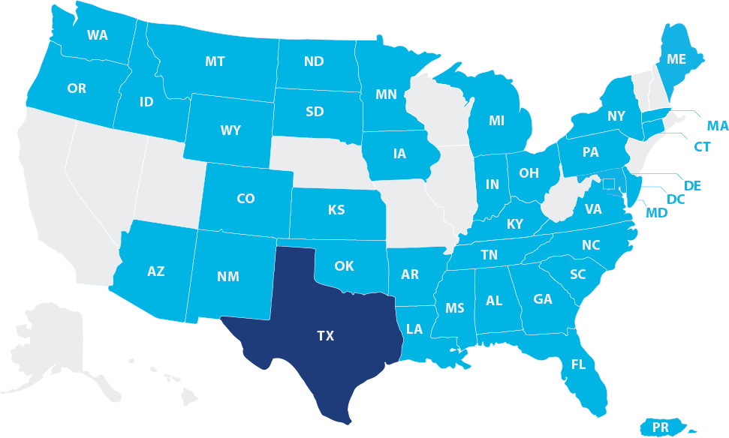

Data:
The Texas PMP
Texas partners with 38 other states, territories, entities, and the Military Health System to share data via the PMP Interconnect.
Partner States

Slide 9
Data: The Opioid Crisis
Every day, 224 people in the United States died from an opioid overdose.​
From 1999 to 2022, 26,767 Texans died of an opioid-related overdose​
There were nearly 10,058 ED visits in Texas in 2022 for opioid-related causes​
One in four Texans have either experienced an opioid overdose or know someone who has​
Four of the nation’s top 25 cities for opioid misuse are in Texas​
Source: Texas Health Data, CDC​

Slide 10
Additional Resources​
Txpmp.org​
Texas Health Data​
Texas State Board of Pharmacy​
Centers for Disease Control Guide to PDMPS​
Substance Abuse and Mental Health Services Administration survey on drug use and health​

